Slide 1

Course locations
15/4 vm+nm L3.3 HC
16/4 vm L3.3 HC
nm L0 WC
17/4 vm L3.3 HC
nm L4 WC
18/4 vm L1 WC -> need replacement
nm L1 HC+WC
22/4 vm L3.3 HC
nm L0 WC
23/4 vm WC
nm WC
24/4 vm+nm L4 WC
25/4 vm+nm L4 HC+WC
6/5 vm+nm L0 internship project
7/5 vm+nm L0 internship project
8/5 vm+nm L4 WC
13/5 nm L4 WC
14/5 vm L4 WC CompOmics + ProteomicsML
15/5 vm L0 WC
16/5 vm/nm poster presentation
Machine Learning Methods for Biomedical Data (D012554)

Slide 2

Course specifications
https://github.com/sdgroeve/Machine_Learning_course_UGent_D012554_2024
Machine Learning Methods for Biomedical Data (D012554)

Slide 3

Course evaluation: Jupyter notebook analysis (20%)
Machine Learning Methods for Biomedical Data (D012554)

Slide 4
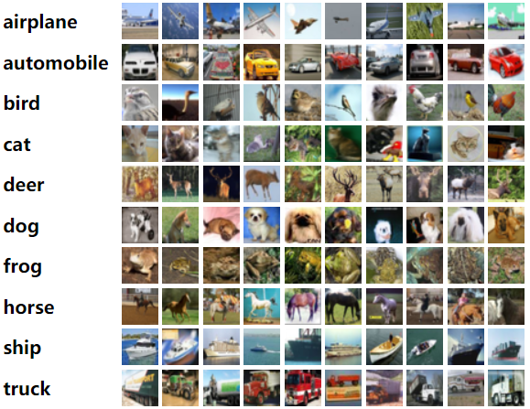
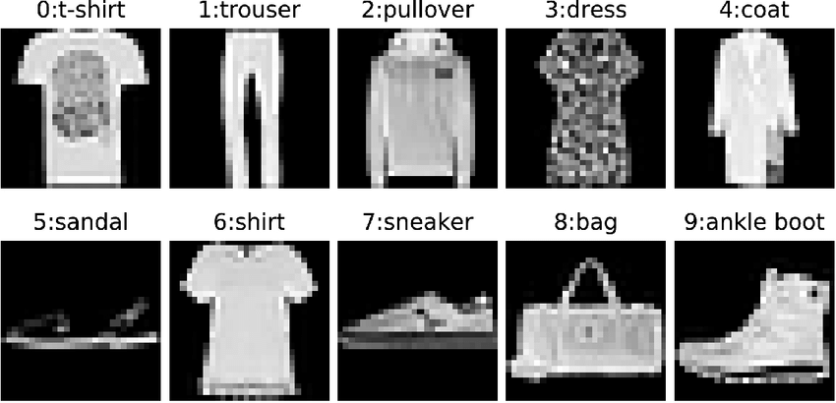
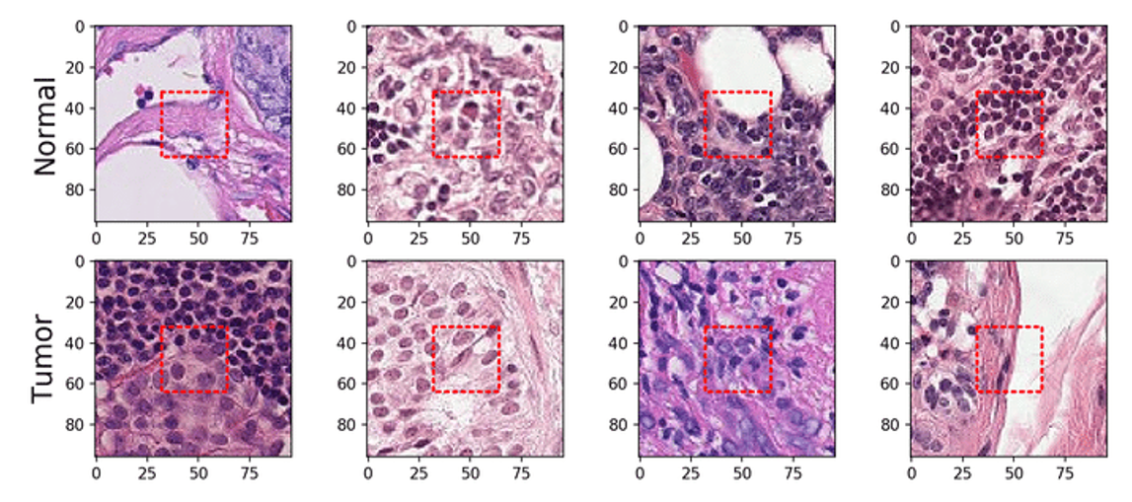
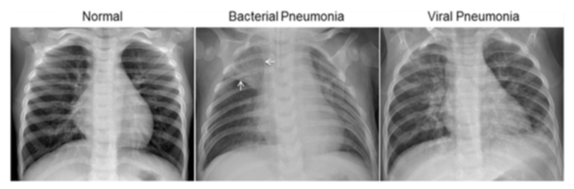
Course evaluation: CNN model building (15%)
Machine Learning Methods for Biomedical Data (D012554)

Slide 5
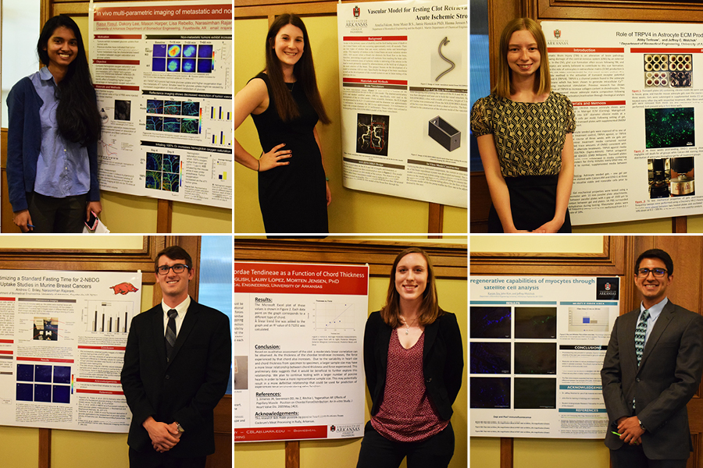
Course evaluation: science poster (15%)
Machine Learning Methods for Biomedical Data (D012554)

Slide 6

Functions Describe the World (prof. dr. Thomas Garrity)
Machine Learning Methods for Biomedical Data (D012554)

Slide 7
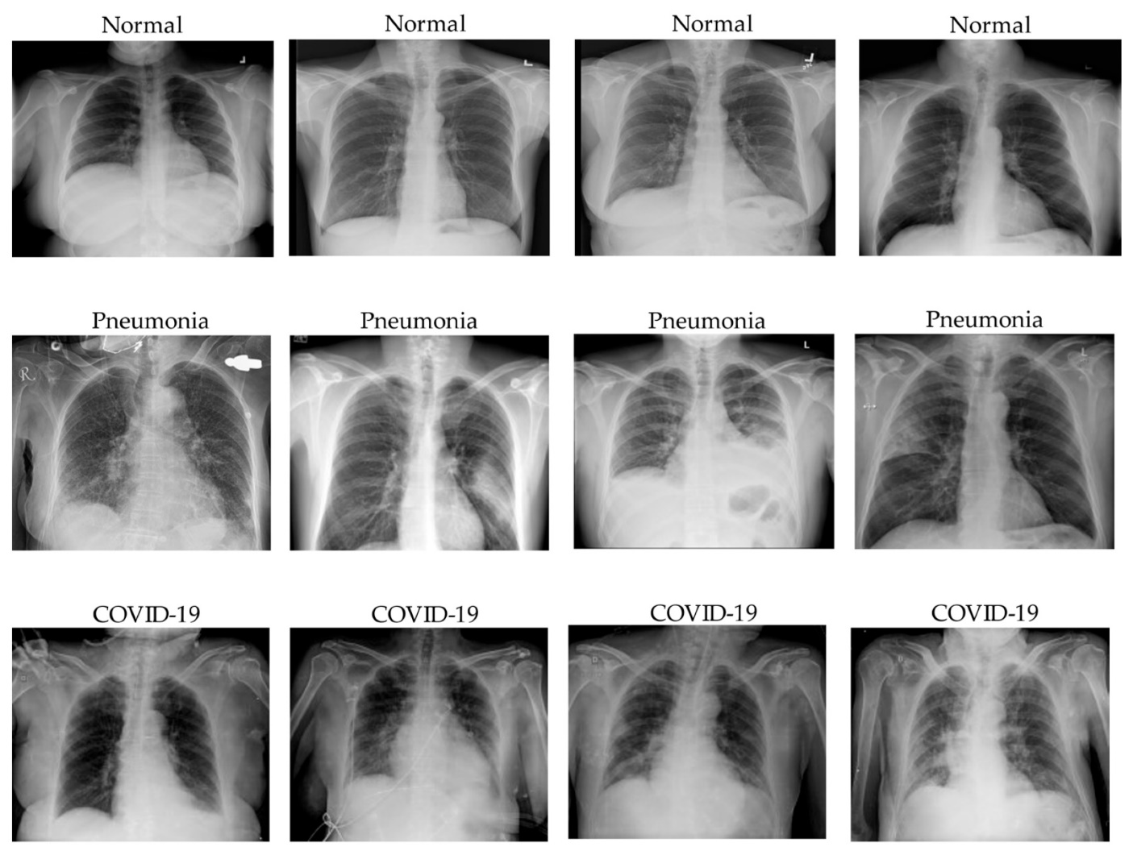
Applications: Disease Diagnosis and Prediction
Machine learning models are widely used for diagnosing diseases from medical imaging, such as detecting cancerous tumours in radiology scans (e.g., breast cancer detection in mammograms) or identifying diabetic retinopathy in eye images.
Source: Le Dinh, T, et al. COVID-19 Chest X-ray Classification and Severity Assessment Using Convolutional and Transformer Neural Networks. Appl. Sci. 2022
Machine Learning Methods for Biomedical Data (D012554)

Slide 8
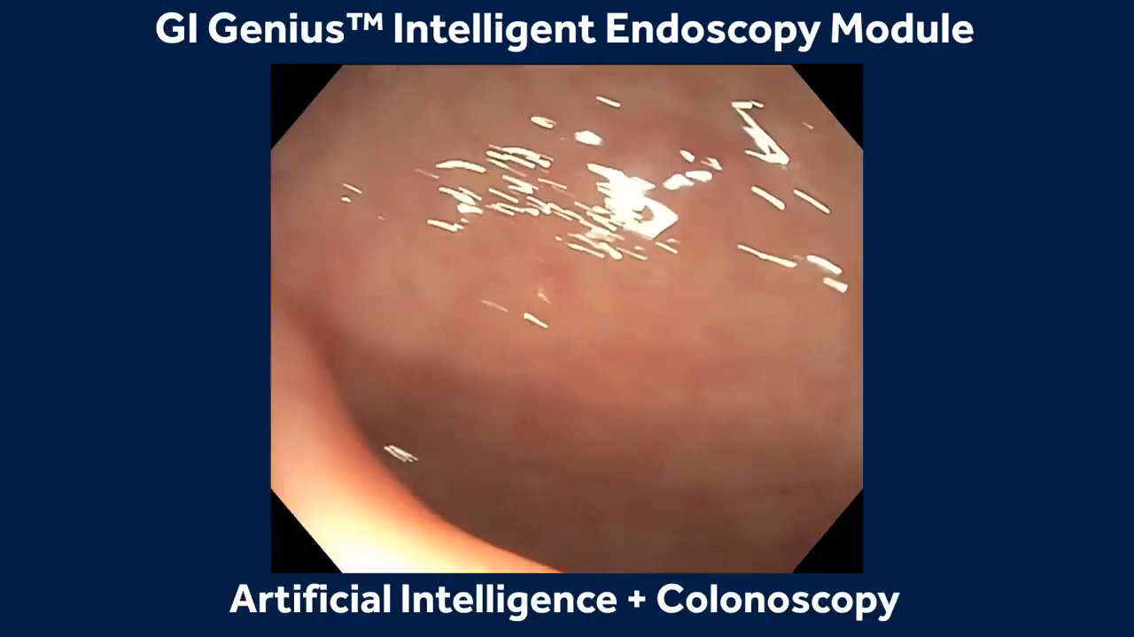
Applications: Disease Diagnosis and Prediction
Machine learning models are widely used for diagnosing diseases from medical imaging (including video), such as detecting cancerous tumours in radiology scans (e.g., breast cancer detection in mammograms) or identifying diabetic retinopathy in eye images.
Another example is deep learning applied to gastroenterology for analysing endoscopic images to detect gastrointestinal anomalies, such as polyps, ulcers, and cancers, enhancing the accuracy of endoscopic diagnoses.
Machine Learning Methods for Biomedical Data (D012554)

Slide 9
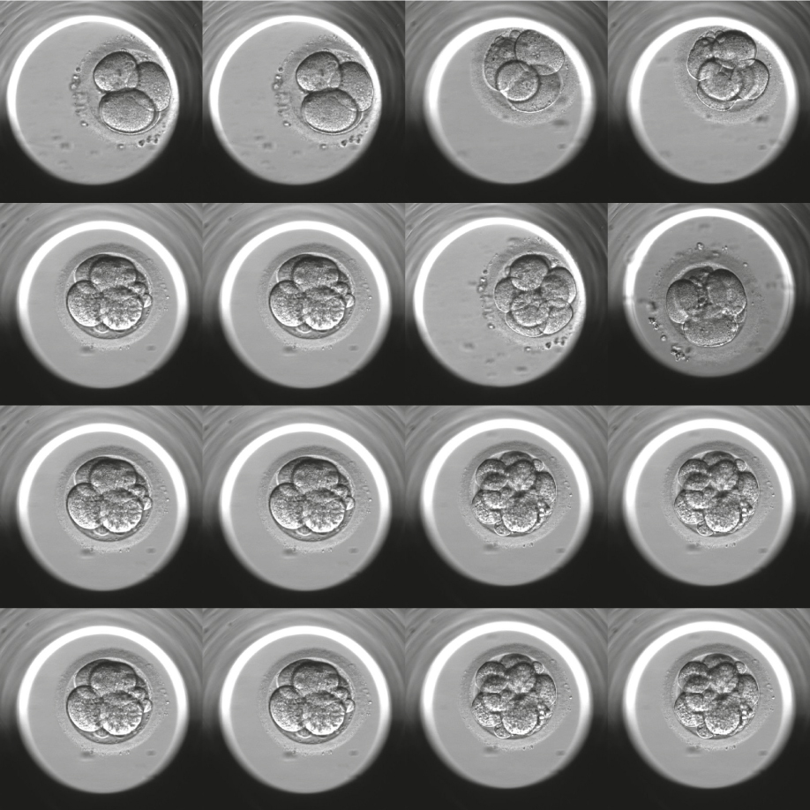
Applications: Disease Diagnosis and Prediction
Machine learning models are widely used for diagnosing diseases from medical imaging (including video), such as detecting cancerous tumours in radiology scans (e.g., breast cancer detection in mammograms) or identifying diabetic retinopathy in eye images.
Another example is machine learning applied to analyse time-lapse imaging data of embryo development, aiming to predict aneuploidy and select euploid embryos without the need for invasive biopsy procedures.
Source: Focus on Reproduction
Machine Learning Methods for Biomedical Data (D012554)

Slide 10
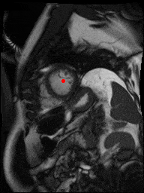
Applications: Disease Diagnosis and Prediction
Machine learning models assist in the segmentation of medical images.
This facilitates the measurement of volumes (e.g., tumors, organs), which is crucial for planning treatments and monitoring disease progression.
Source: kaggle.com/second-annual-data-science-bowl (2015)
Machine Learning Methods for Biomedical Data (D012554)

Slide 11
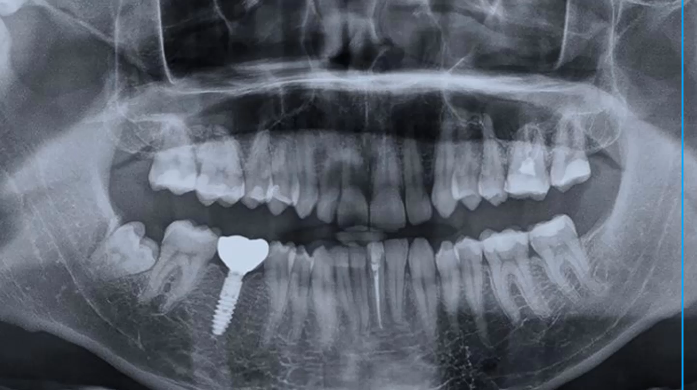
Applications: Disease Diagnosis and Prediction
Machine learning models assist in the segmentation of medical images.
Machine Learning Methods for Biomedical Data (D012554)

Slide 12
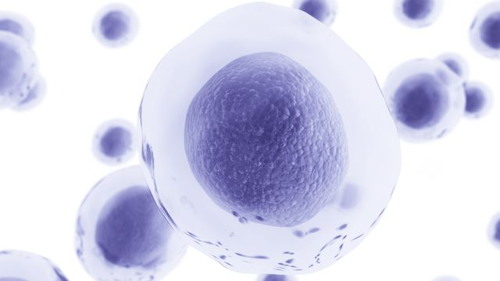
Applications: Personalized Medicine
Machine learning plays a key role in personalized medicine, where models are used to predict patient response to different treatments.
This approach can optimize treatment plans based on the individual’s genetic makeup, improving effectiveness and reducing side effects.
Examples are:
predicting drug responses
cancer treatment personalization
personalized treatment plans for chronic diseases
Machine Learning Methods for Biomedical Data (D012554)
Notes:
Cancer Treatment Personalization: Deep learning algorithms analyze genomic data, medical images, and clinical information to identify specific mutations and patterns in cancer cells. This can help in selecting the most effective treatments for individual patients, such as targeted therapy or immunotherapy, based on the genetic makeup of their tumors.
Predicting Drug Responses: By integrating deep learning with pharmacogenomics (the study of how genes affect a person's response to drugs), models can predict how individual patients are likely to respond to various medications. This approach helps in optimizing drug dosages and reducing the risk of adverse drug reactions.
Personalized Treatment Plans for Chronic Diseases: In conditions like diabetes and cardiovascular diseases, deep learning models analyze patients' health records, lifestyle data, and continuous monitoring data to tailor treatment plans that adjust to changing health statuses and individual responses to treatment.

Slide 13
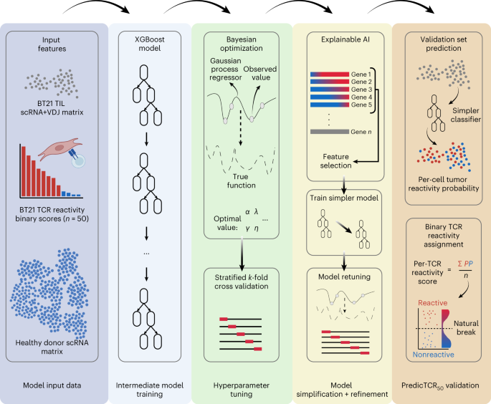
Applications: Personalized Medicine
Machine learning quickly and accurately identifies key T-cell receptors for personalized cancer treatment, improving therapy development.
Source: Tan, C.L. et al. Prediction of tumor-reactive T cell receptors from scRNA-seq data for personalized T cell therapy. Nat Biotechnol (2024)
Machine Learning Methods for Biomedical Data (D012554)
Notes:
ScRNA data from healthy donors, as well as scRNA + VDJ and experimentally derived tumor-reactivity data for the 50 most frequent TCR TIL clonotypes from sample BT21, were used to train an intermediate model using XGBoost. Due to the sparse nature of scRNA data, we optimized this intermediate model by first performing Bayesian optimization to tune hyperparameters with stratified k-fold cross-validation. Subsequently we identified the top features (that is, genes) in this intermediate model using explainable AI SHAP, and then trained a simpler model using only these features to prevent overfitting to the training data. This simpler model was retuned as before and then applied to the remaining BT21 TIL data. Per-cell reactivity probabilities calculated by the classifier were averaged for each TCR clonotype, and the Fisher–Jenk natural break was used to determine the appropriate minimum threshold for calling TCRs as tumor reactive.

Slide 14
Applications: Drug Discovery and Development
Machine learning algorithms can analyse vast chemical and biological data to identify potential drug candidates.
This process speeds up the discovery of new drugs and can predict their efficacy and safety profile, significantly reducing the time and cost of drug development.
Machine Learning Methods for Biomedical Data (D012554)

Slide 15
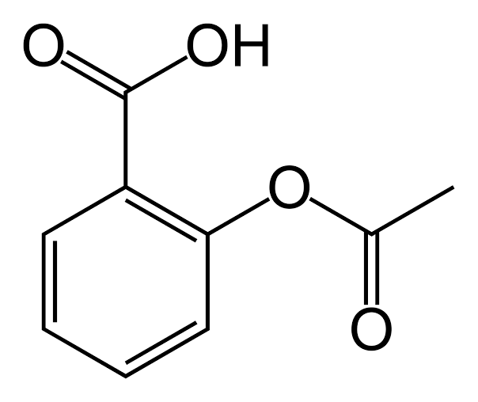
Applications: Drug Discovery and Development
Machine learning algorithms can analyse vast chemical and biological data to identify potential drug candidates.
Source: Aspirin
Machine Learning Methods for Biomedical Data (D012554)

Slide 16
Applications: Drug Discovery and Development
Machine learning algorithms can analyse vast chemical and biological data to identify potential drug candidates.
Source: Aspirin
Machine Learning Methods for Biomedical Data (D012554)

Slide 17
Applications: Drug Discovery and Development
Machine learning algorithms can analyse vast chemical and biological data to identify potential drug candidates.
CC(=O)OC1=CC=CC=C1C(=O)O
Source: Aspirin
Machine Learning Methods for Biomedical Data (D012554)

Slide 18
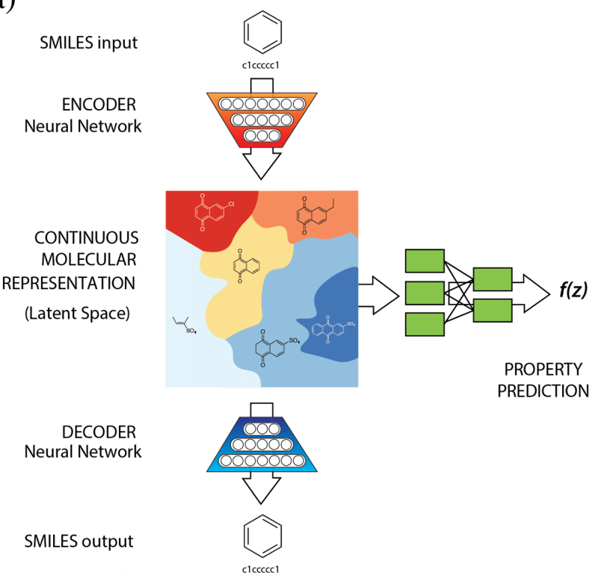
Applications: Drug Discovery and Development
Machine learning algorithms can analyse vast chemical and biological data to identify potential drug candidates.
Source: Gómez-Bombarelli et al. ACS Central Science (2019)
Machine Learning Methods for Biomedical Data (D012554)

Slide 19
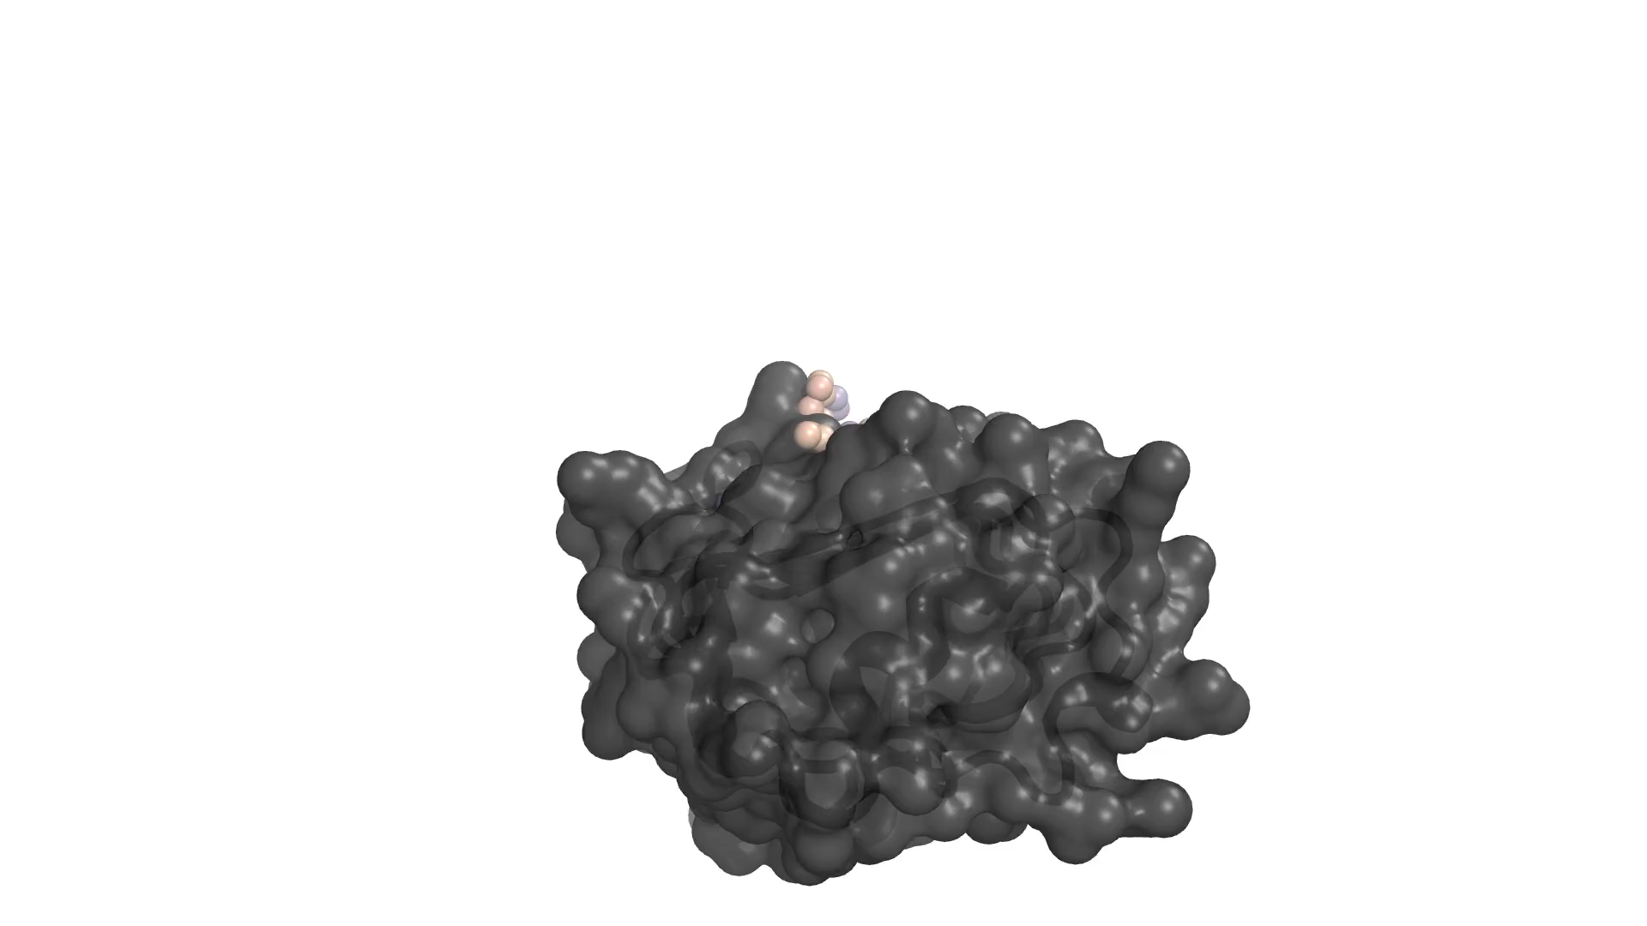
Applications: Drug Discovery and Development
Machine learning algorithms can analyse vast chemical and biological data to identify potential drug candidates.
Here a diffusion model generates a novel protein that binds to the insulin receptor.
Source: https://www.bakerlab.org/2023/03/30/rf-diffusion-now-free-and-open-source/
Machine Learning Methods for Biomedical Data (D012554)

Slide 20

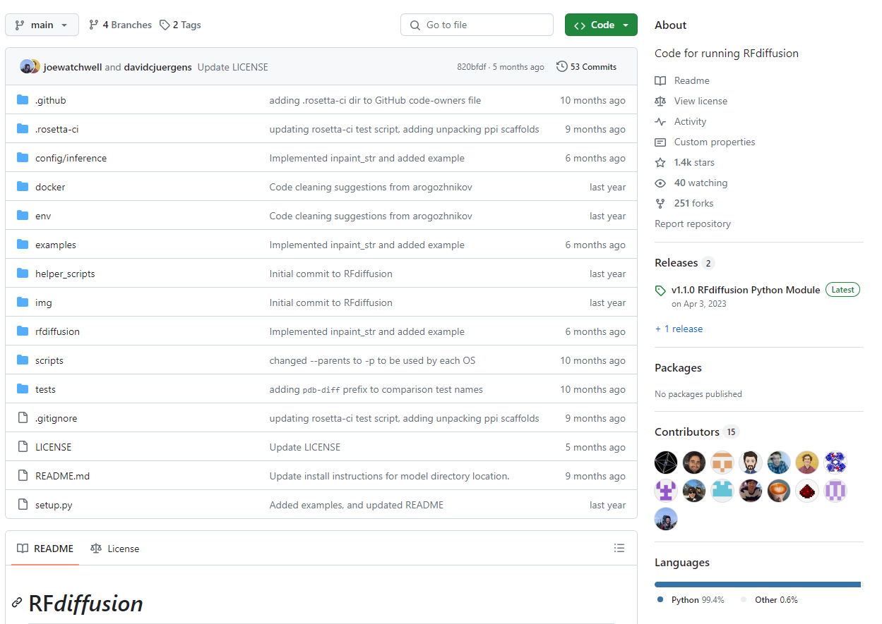

Applications: Drug Discovery and Development
Machine learning algorithms can analyse vast chemical and biological data to identify potential drug candidates.
Here a diffusion model generates a novel protein that binds to the insulin receptor.
https://github.com/RosettaCommons/RFdiffusion
Source: https://www.bakerlab.org/2023/03/30/rf-diffusion-now-free-and-open-source/
Machine Learning Methods for Biomedical Data (D012554)

Slide 21
Applications: Genomics, Transcriptomics, Proteomics, … , -omics
Machine learning models are important for the analysis of omics data generated by Genomics, Proteomics, Transcriptomics, Metabolomics, Epigenomics, Pharmacogenomics, Microbiomics, Lipidomics and Glycomics to understand variations and their association with diseases.
They can classify patients based on biomedical (bio)markers, helping in the identification of molecular diseases and the development of therapies.
Machine Learning Methods for Biomedical Data (D012554)
Notes:
Genomics: Machine learning models analyze whole-genome sequencing data to find genetic variants associated with diseases like cancer, heart disease, or rare genetic disorders. They can predict the effect of these variants on disease risk and help in identifying potential targets for therapy.
Proteomics: In proteomics, machine learning is used to analyze complex protein expression patterns and modifications. It can help in discovering biomarkers for diseases, understanding the progression of conditions such as Alzheimer's disease, or finding proteins that may be targeted by new drugs.
Transcriptomics: Machine learning models analyze RNA sequence data to understand gene expression patterns and their changes in different diseases. For example, they can identify which genes are turned on or off in tumor cells versus normal cells, aiding in cancer diagnosis and treatment selection.
Metabolomics: Machine learning helps in analyzing the complete set of metabolites within a biological sample. It can identify metabolic signatures associated with diseases such as diabetes or metabolic syndrome, and contribute to understanding disease mechanisms and responses to treatment.
Epigenomics: Machine learning models study epigenetic changes, like DNA methylation patterns, that affect gene expression without altering the DNA sequence. They can identify epigenetic markers linked to diseases like schizophrenia or autoimmune diseases, offering insights into potential interventions.
Pharmacogenomics: In pharmacogenomics, machine learning predicts how individuals will respond to medications based on their genetic makeup. This aids in personalizing drug prescriptions to maximize efficacy and minimize adverse effects.
Microbiomics: Machine learning models are used to analyze the complex communities of microbes in the human body. They can find correlations between microbial populations and diseases such as inflammatory bowel disease, obesity, or even mental health conditions.
Lipidomics: Machine learning assists in studying the roles of lipids in cells and tissues and their variations in different diseases. It can be used to identify lipid biomarkers for conditions like atherosclerosis or fatty liver disease.
Glycomics: Machine learning is applied to understand the structure and function of glycans (complex sugars) and their interactions with other biological molecules, which can be crucial for disease processes and therapeutic targets.

Slide 22
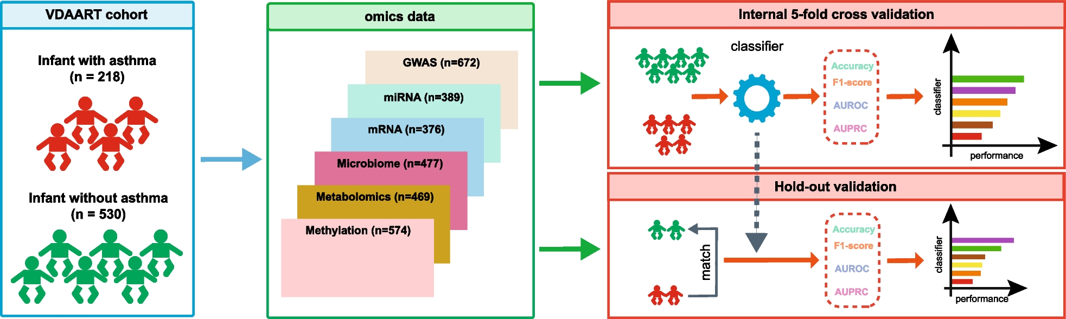
Applications: Genomics, Transcriptomics, Proteomics, … , -omics
They can classify patients based on biomedical (bio)markers, helping in the identification of molecular diseases and the development of therapies.
Source: Wang, XW. et al. Benchmarking omics-based prediction of asthma development in children. Respir Res
Machine Learning Methods for Biomedical Data (D012554)
Notes:
Genomics: Machine learning models analyze whole-genome sequencing data to find genetic variants associated with diseases like cancer, heart disease, or rare genetic disorders. They can predict the effect of these variants on disease risk and help in identifying potential targets for therapy.
Proteomics: In proteomics, machine learning is used to analyze complex protein expression patterns and modifications. It can help in discovering biomarkers for diseases, understanding the progression of conditions such as Alzheimer's disease, or finding proteins that may be targeted by new drugs.
Transcriptomics: Machine learning models analyze RNA sequence data to understand gene expression patterns and their changes in different diseases. For example, they can identify which genes are turned on or off in tumor cells versus normal cells, aiding in cancer diagnosis and treatment selection.
Metabolomics: Machine learning helps in analyzing the complete set of metabolites within a biological sample. It can identify metabolic signatures associated with diseases such as diabetes or metabolic syndrome, and contribute to understanding disease mechanisms and responses to treatment.
Epigenomics: Machine learning models study epigenetic changes, like DNA methylation patterns, that affect gene expression without altering the DNA sequence. They can identify epigenetic markers linked to diseases like schizophrenia or autoimmune diseases, offering insights into potential interventions.
Pharmacogenomics: In pharmacogenomics, machine learning predicts how individuals will respond to medications based on their genetic makeup. This aids in personalizing drug prescriptions to maximize efficacy and minimize adverse effects.
Microbiomics: Machine learning models are used to analyze the complex communities of microbes in the human body. They can find correlations between microbial populations and diseases such as inflammatory bowel disease, obesity, or even mental health conditions.
Lipidomics: Machine learning assists in studying the roles of lipids in cells and tissues and their variations in different diseases. It can be used to identify lipid biomarkers for conditions like atherosclerosis or fatty liver disease.
Glycomics: Machine learning is applied to understand the structure and function of glycans (complex sugars) and their interactions with other biological molecules, which can be crucial for disease processes and therapeutic targets.

Slide 23
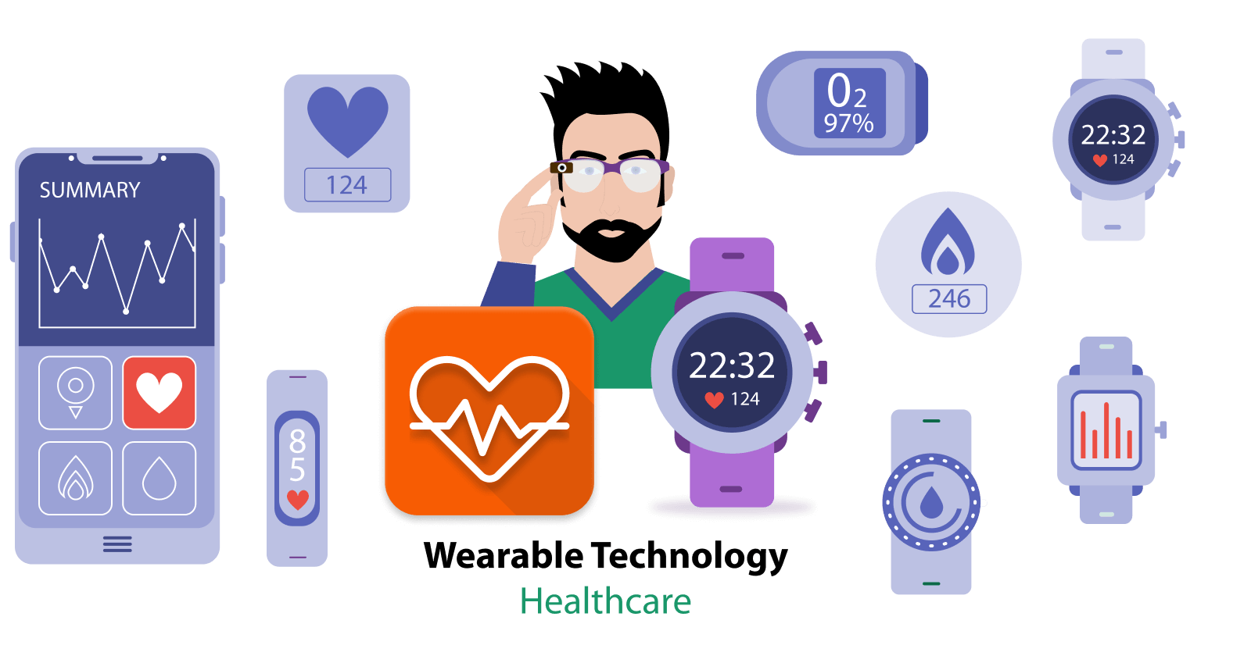
Applications: Wearable Health Monitoring
Machine learning algorithms analyse data from wearable devices to monitor health indicators in real-time, predict health events, and provide personalized health advice.
This is key for chronic disease management and preventive healthcare.
Machine Learning Methods for Biomedical Data (D012554)

Slide 24

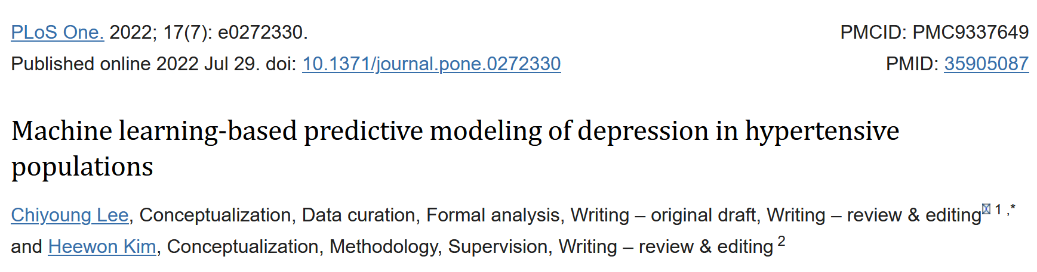
Applications: Mental Health Analysis
Machine learning models analyse patterns in speech, typing speed, and social media usage to detect signs of mental health issues, such as depression or anxiety.
This aids in early detection and intervention.
Features in Table 2
Machine Learning Methods for Biomedical Data (D012554)

Slide 25

Applications: Healthcare Operations
Machine learning models are used to optimize hospital operations, such as
predicting patient admission rates to manage hospital beds
scheduling surgeries and medical staff
reducing wait times for patients
…
Machine Learning Methods for Biomedical Data (D012554)

Slide 26
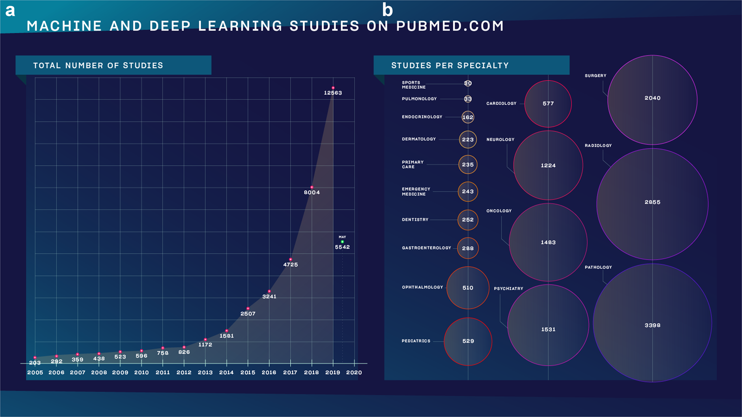
Why follow this course?
Meskó, B., Görög, M. A short guide for medical professionals in the era of artificial intelligence. npj Digit. Med. 3, 126 (2020)
Machine Learning Methods for Biomedical Data (D012554)

Slide 27
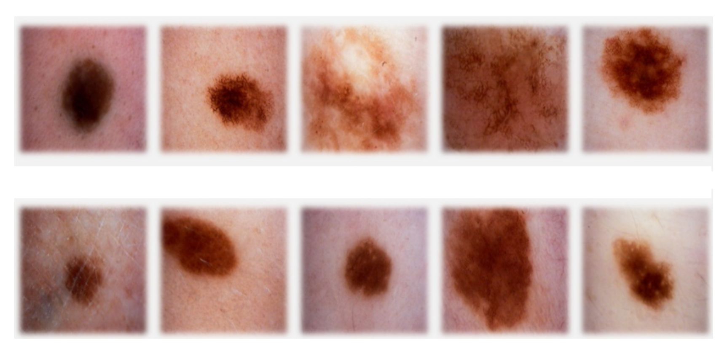
classification
sign of cancer
top row malignant
bottom row benign
Machine Learning Methods for Biomedical Data (D012554)

Slide 28
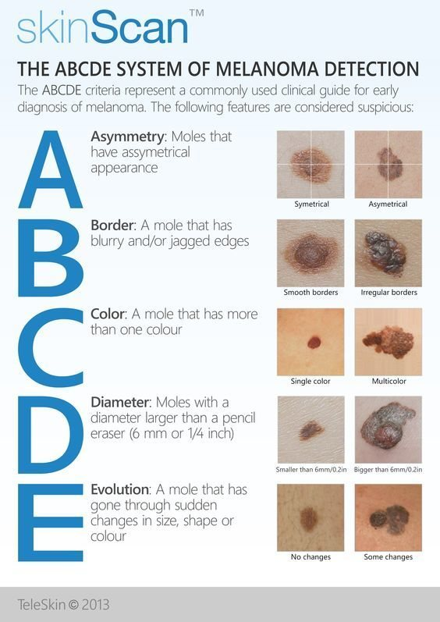
classification
Machine Learning Methods for Biomedical Data (D012554)

Slide 29
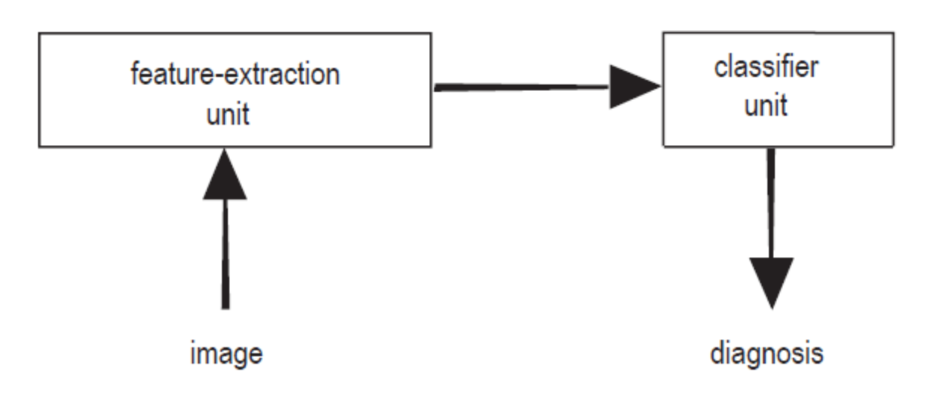
classification: terminology
feature extraction: features (a.k.a. properties or attributes)
data set, sample (a.k.a. example, instance or data point), label (a.k.a. target)
Machine Learning Methods for Biomedical Data (D012554)

Slide 30
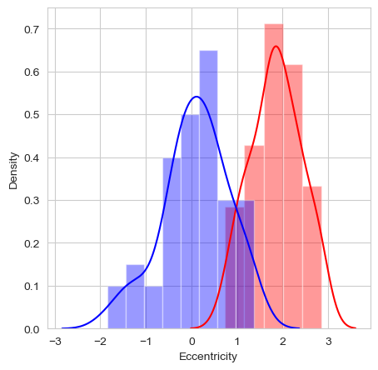
classification: a feature
feature: eccentricity of lesion (how nearly circular the lesion is)
Machine Learning Methods for Biomedical Data (D012554)

Slide 31

classification: the model
feature: eccentricity of lesion (how nearly circular the lesion is)
model: threshold t
Machine Learning Methods for Biomedical Data (D012554)

Slide 32
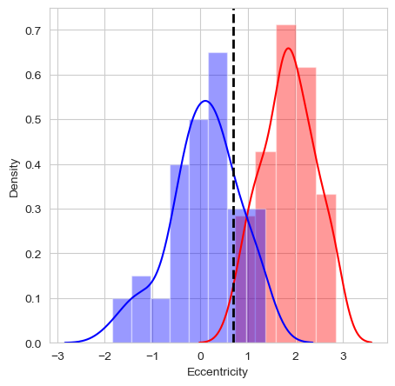
classification: the model
feature: eccentricity of lesion (how nearly circular the lesion is)
model: threshold t: consequence of the predictions
Machine Learning Methods for Biomedical Data (D012554)

Slide 33
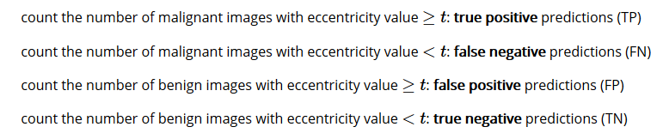
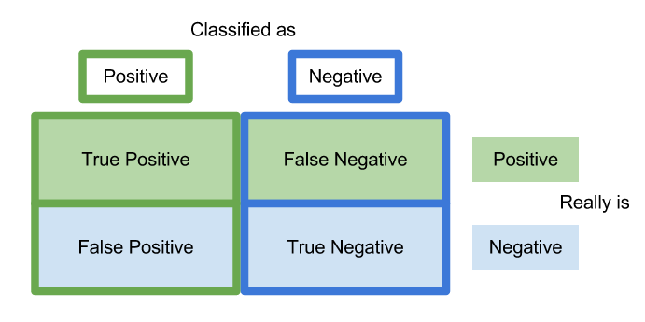
classification: prediction errors
malignant: positive class
benign: negative class
Machine Learning Methods for Biomedical Data (D012554)

Slide 34
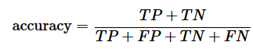
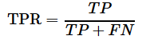
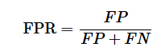
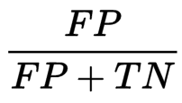
classification: prediction errors
Machine Learning Methods for Biomedical Data (D012554)

Slide 35
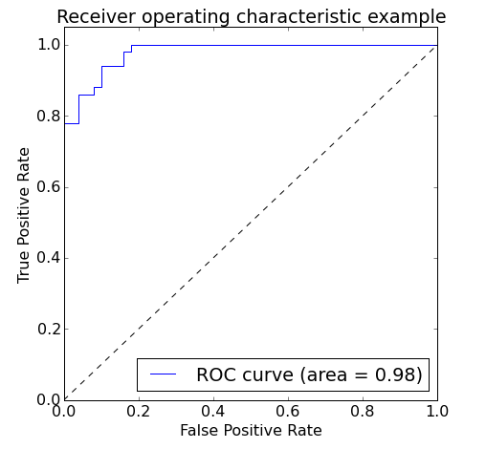
classification: prediction errors
model that classifies all images as malignant: TPR=1 and FPR=1
model that classifies all images a benign: TPR=0 and FPR=0
vary threshold t
Area Under the Curve (AUC)
Machine Learning Methods for Biomedical Data (D012554)

Slide 36
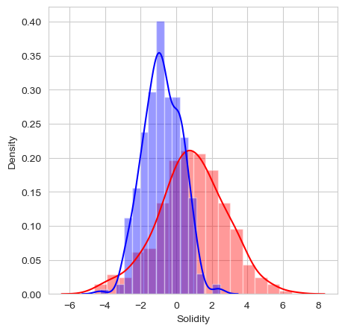
classification: multi-dimensional
add another feature?
feature vector X
Euclidean vector space
Machine Learning Methods for Biomedical Data (D012554)

Slide 37
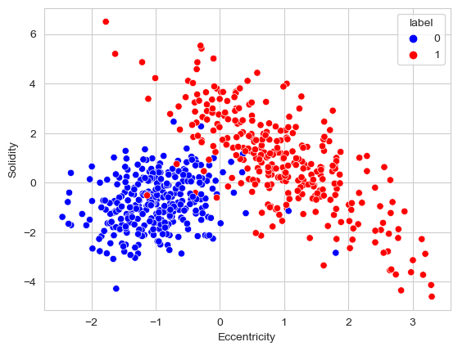
classification: multi-dimensional
feature vector X
Euclidean vector space
Machine Learning Methods for Biomedical Data (D012554)

Slide 38
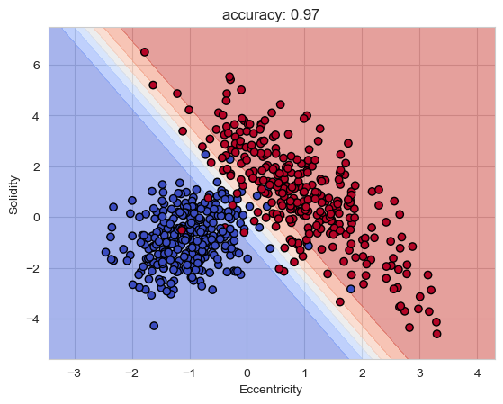
classification: multi-dimensional
linear decision boundary
blue region malignant, red region benign
yet more features
can’t look at the decision boundary
more complex
Machine Learning Methods for Biomedical Data (D012554)

Slide 39
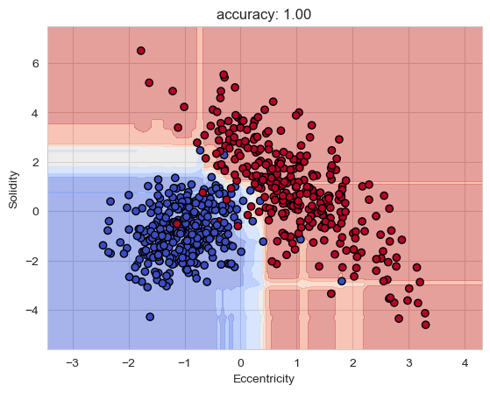
classification: model complexity
unseen external images
generalization
overfitting
Machine Learning Methods for Biomedical Data (D012554)

Slide 40
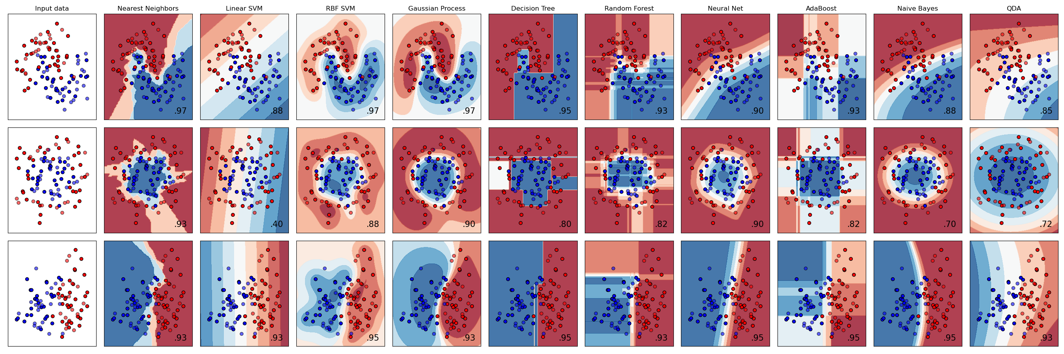
scikit-learn
Machine Learning Methods for Biomedical Data (D012554)

Slide 41
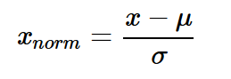
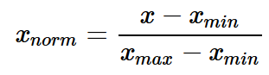
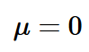
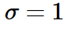
data normalization
make all features same scale
Eccentricity [0,100], Solidity [-5,7]
weights all features equally in their representation
standardization
min-max scaling: scale the features to a fixed range
Machine Learning Methods for Biomedical Data (D012554)

Slide 42
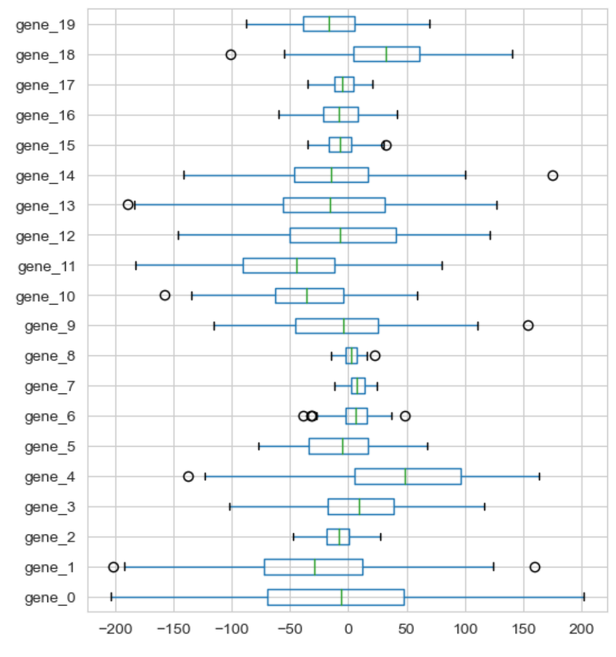
data normalization
Machine Learning Methods for Biomedical Data (D012554)

Slide 43
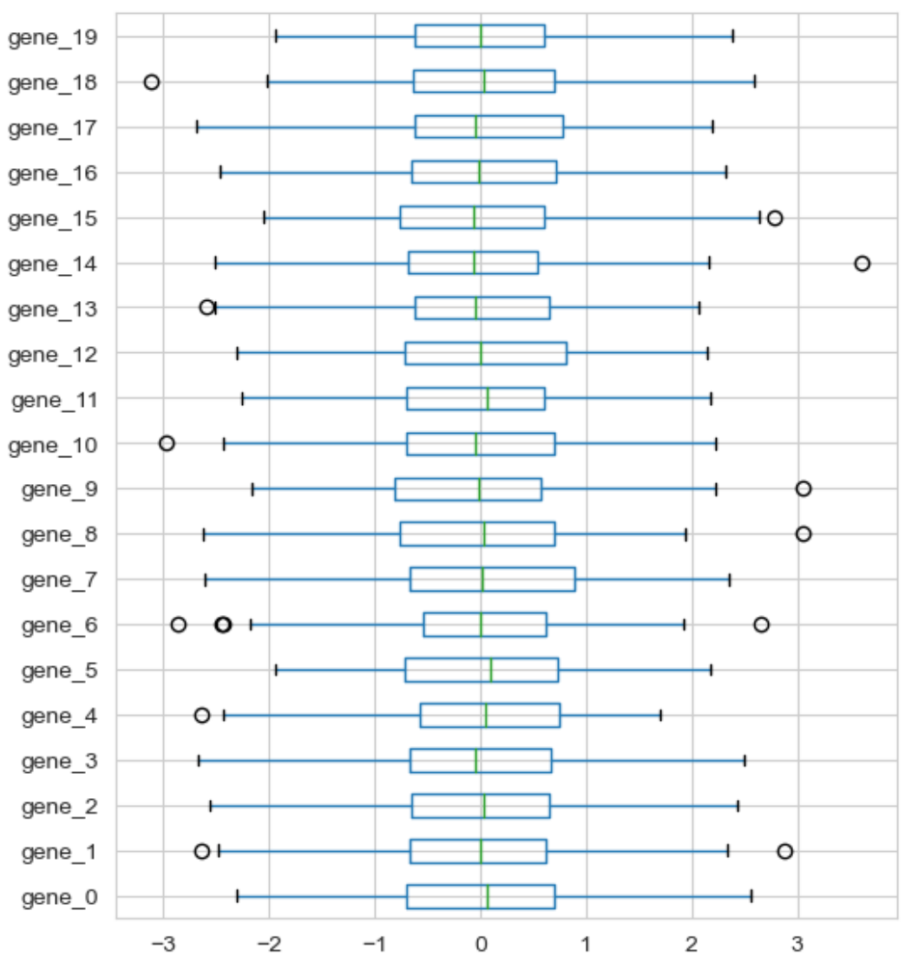
data normalization: standardization
Machine Learning Methods for Biomedical Data (D012554)

Slide 44
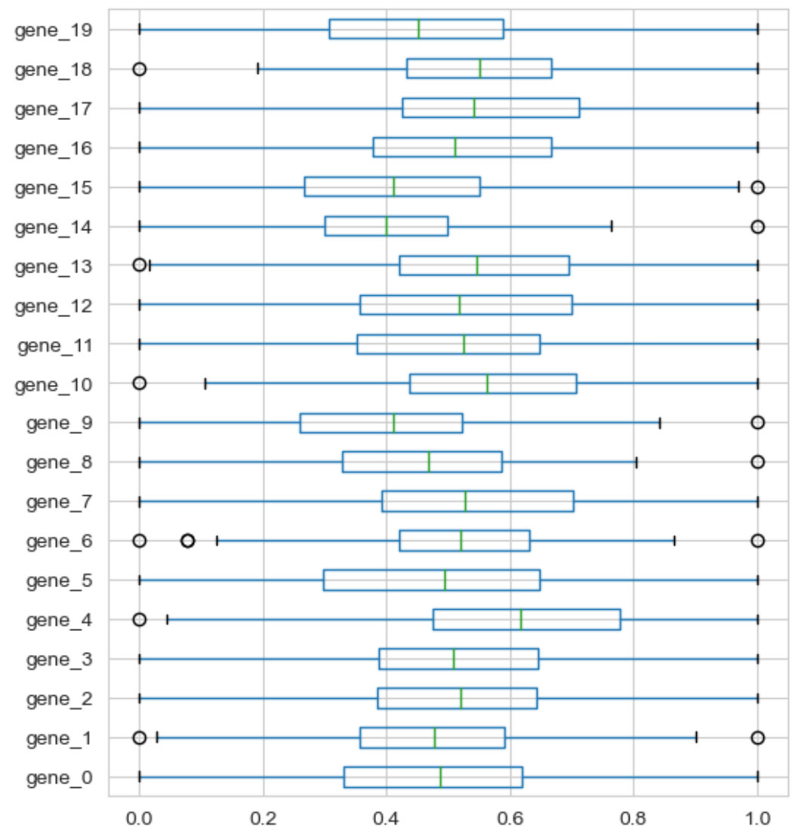
data normalization: min-max scaling
Machine Learning Methods for Biomedical Data (D012554)

